Slide 1

ML PROJECT
The
Beatles
Patterns and trends in their songwriting

Slide 2

Table of Contents
Points for discussion:
Introduction
Data collection
Preprocessing
EDA
Modeling
Results
Conclusion

Slide 3
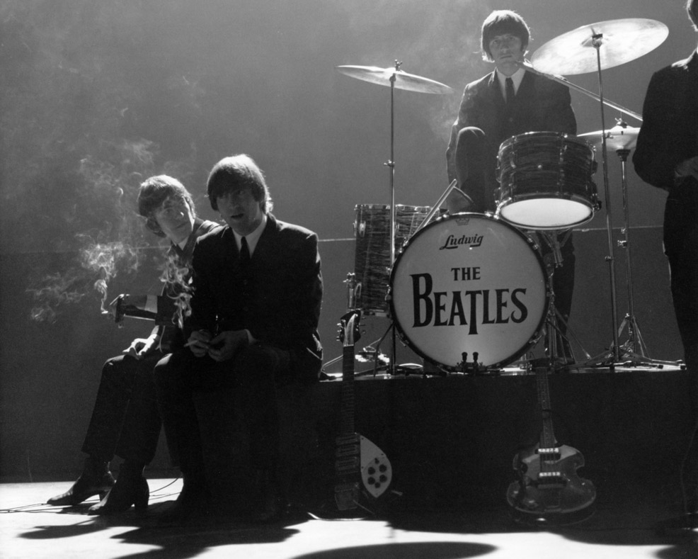
Are there patterns or trends in the Beatles songwriting and composition?
Emerging from 1960s Liverpool, The Beatles reshaped music with their innovative style. Lennon's depth, McCartney's melodies, Harrison's spirituality, and Starr's rhythmic flair combined to create an unparalleled legacy.
Can we identify quantifiable trends on their composition complexity over time?
Can we predict the main composer of a song based on its attributes?

Slide 4

Data Collection
Step 1
Step 2
Step 3
Step 4
Step 5
List of all Beatles songs.
List of each key chords scale
Songs chords and key via Scraping.
Scrape missing song keys
Putting it all together
Including main composer, album and release year
List diatonic chords derived from each major or minor key.
From chords website, get chords used in each song.
Find key of songs where initial scraping did not include it.
Complete dataset including diatonic vs chromatic chords and complexions.

Slide 5
Key | I | ii | iii | IV | V | vi* | vii
C major | C | Dm | Em | F | G | Am | Bdim
C# major | C# | D#m | E#m | F# | G# | A#m | B#dim
Db major | Db | Ebm | Fm | Gb | Ab | Bbm | Cdim
D major | D | Em | F#m | G | A | Bm | C#dim
Eb major | Eb | Fm | Gm | Ab | Bb | Cm | Ddim
E major | E | F#m | G#m | A | B | C#m | D#dim
F major | F | Gm | Am | Bb | C | Dm | Edim
F# major | F# | G#m | A#m | B | C# | D#m | E#dim
Gb major | Gb | Abm | Bbm | Cb | Db | Ebm | Fdim
G major | G | Am | Bm | C | D | Em | F#dim
Ab major | Ab | Bbm | Cm | Db | Ebm | Fm | Gdim
A major | A | Bm | C#m | D | E | F#m | G#dim
Bb major | Bb | Cm | Dm | Eb | F | Gm | Adim
B major | B | C#m | D#m | E | F# | G#m | A#dim
Key
Chord
Result
C major
G major
Dmadd9
B
Diatonic: Dm
Chromatic: n/a
Complexion: add9
Diatonic: n/a
Chromatic: B
Complexion: n/a

Slide 6
Data Scraping failed due to captcha.
Initial scraping site returned missing values for keys and even chords for some songs.
Scraping not recognizing characters such as ” ’ ” from songs list.
Challenges
Manually completed missing information.
Cleaned data, dropping duplicate songs and dropping songs not composed by any beatle.
Sliced album release year and transformed it into type int
Transformed scraped chords into sets of diatonic chords, chromatic chords and complexions
Preprocessing

Slide 7
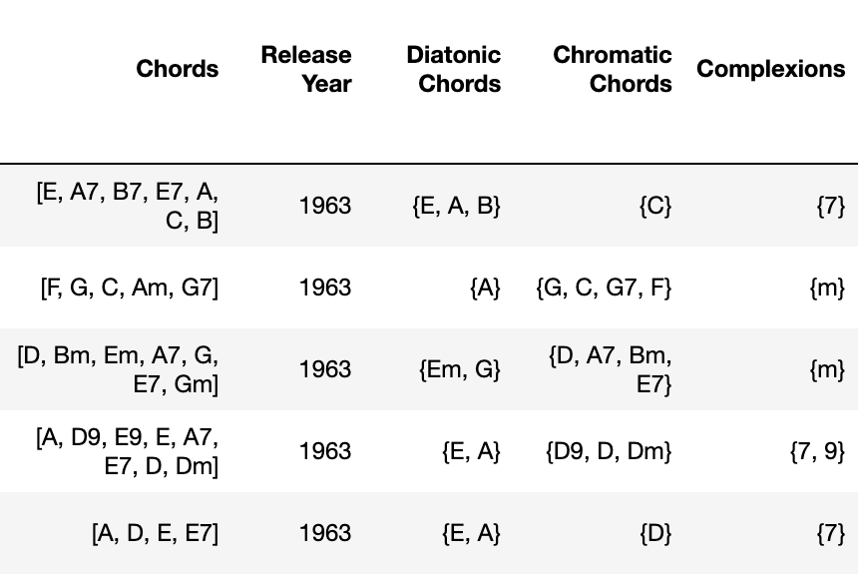

Slide 8
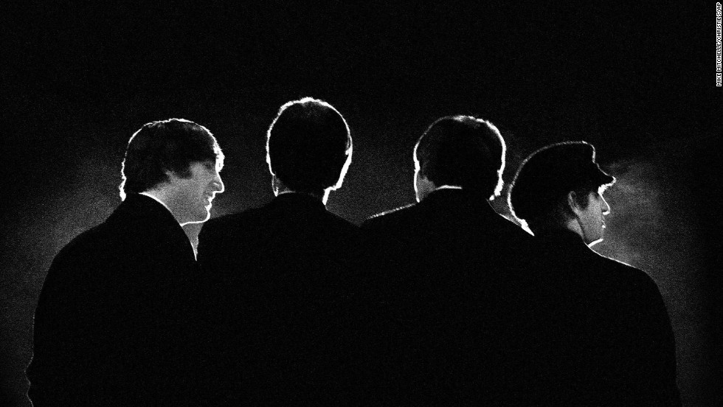
Exploratory Data Analysis

Slide 9
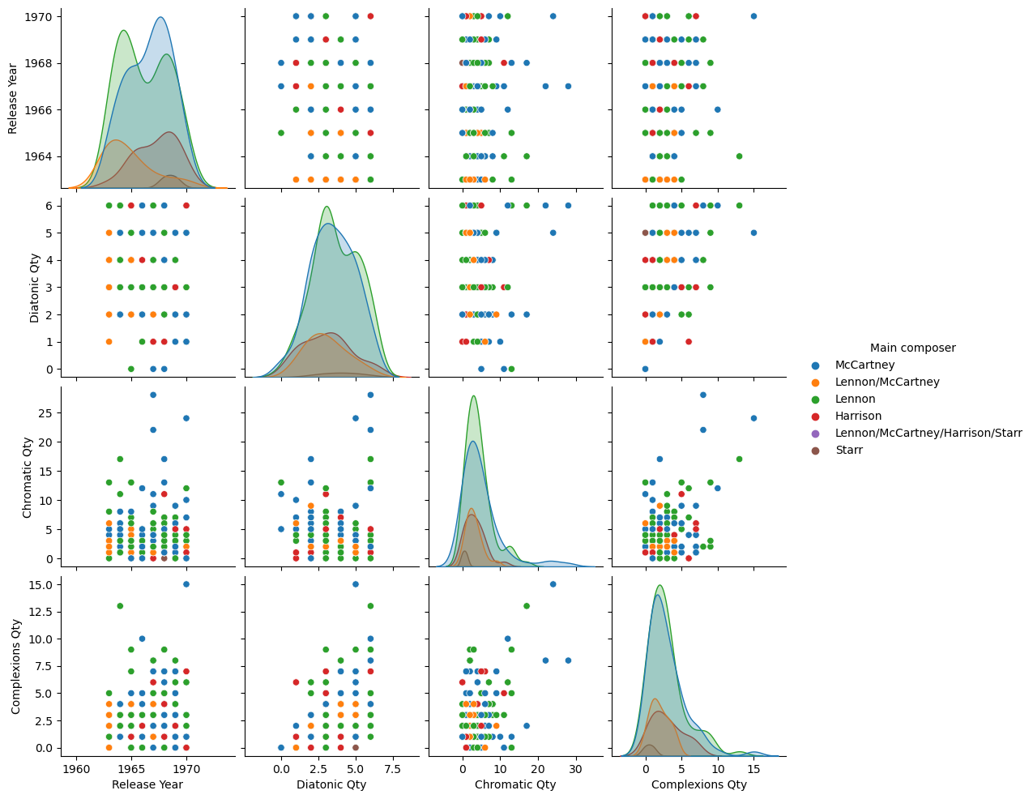
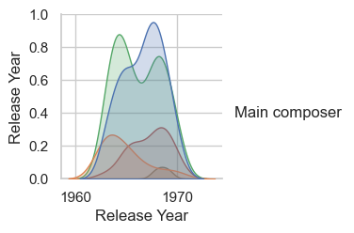

Slide 10
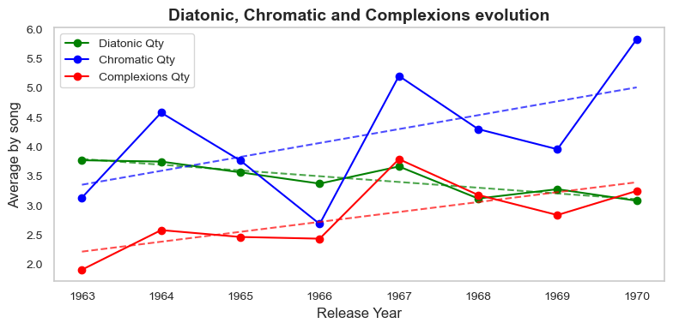

Slide 11
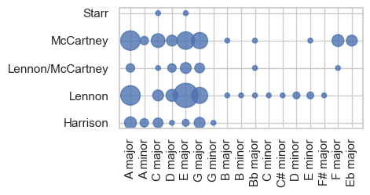

Slide 12
Remote Work Suitability by Industry
Item 5
20%
Item 1
20%
As of January 2021
Item 4
20%
Item 2
20%
More and more companies realize that specific job titles and profiles can be accomplished while working from home.
Item 3
20%

Slide 13
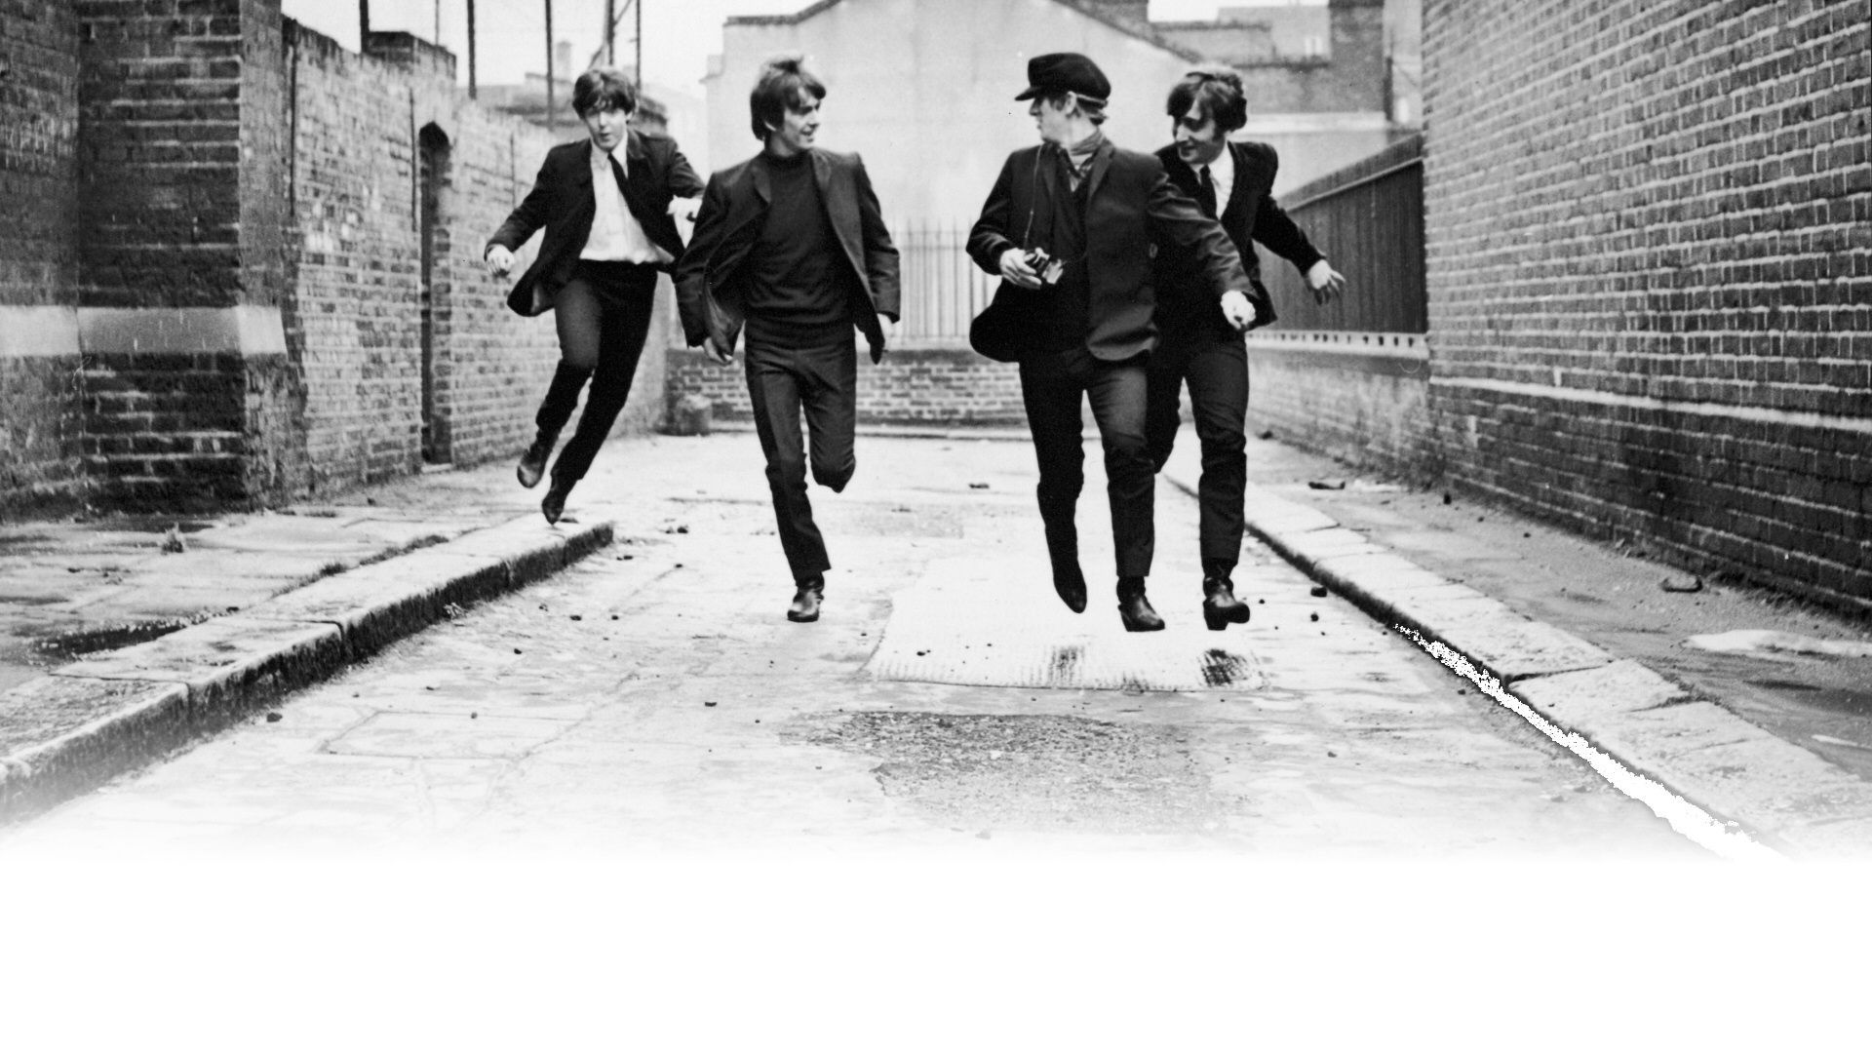
Can I predict the composer of a song based on the release year and the amount of diatonic chords, chromatic chords and complexions?

Slide 14



Keeping your company and employees safe
The importance of cybersecurity in the workplace
Avoid compromising the security of the platforms you use within the company by investing heavily in cybersecurity. Secure your company's data by looking into the best platforms out there that can protect against cybercriminals, hackers, and other fraudulent acts.

Slide 15
On Company Growth
How tech helps companies evolve and innovate
New Avenues for Progress
Ease of
Management
Better Platforms
for Employees
Technology presents new ways to engage with consumers
and provide new services
they may need in this age
of advanced tech.
Businesses are now able to improve the way they operate, from streamlining processes
to handling consumer transactions.
Employees have access to
a vast array of tools to improve the way they work, no matter how complex a task.

Slide 16
On Employee Happiness
Easier Ways of Working
Several platforms offer different tools and features employees can use to make each task more convenient
and effective.
Faster Means of Communication
Interacting with colleagues and sending out a message
to anyone in and out of the country takes no time at all.
How tech makes accomplishing work easy and satisfying
Effective Time Management
Getting work done faster means employees can dedicate more time to life outside of work, especially for remote positions.

Slide 17

Is remote work here to stay?
How working from home might be the way to go
Now that it's become even more evident that finishing tasks and communicating with colleagues can all be quickly done even when every employee stays at home, plenty of companies see how remote work is the better path to take. It's cost-effective, easy, and safe, so it's no wonder why some businesses are starting to make remote work the norm.

Slide 18
While remote work has its perks,
the ability to switch off after a day's work may be even more difficult as you find that the space you spend hours working in is the same space that used to only be for rest and relaxation.

Slide 19

What's Next in Tech Workspace
Increased task automation and use of artificial intelligence.
Extra focus on high-value tasks.
Continuous investment in cybersecurity and security technology.
A better conscious focus on mental health.
Greater geographic distribution and representation of the workforce.

Slide 20
Do you have
any questions?
Send it to us! We hope you learned something new.

Slide 21






























Free Icons
Use these free recolorable icons
and illustrations in your Canva design

